Slide 1
MATLAB
Class 1: Basics part 1

Slide 2

Goals of this MATLAB course
Taking you from MATDRAB to MATFAB
By the end of the course, you should be comfortable reading MATLAB code, writing basic scripts, plotting data, and preforming basic analyses

Slide 3

The philosophy of a programing language
What language do computer speak?
Is it like Portuguese? French?
How are computer languages different than English languages?
What is an algorithm?

Slide 4
MATLAB introduction
Proprietary programing language
Interpreted language
User friendly
Many toolboxes and addons
Designed for matrix operations, signal processing, equation solving

Slide 5

MATLAB Environment
Command Window
Current Folder
Workspace

Slide 6
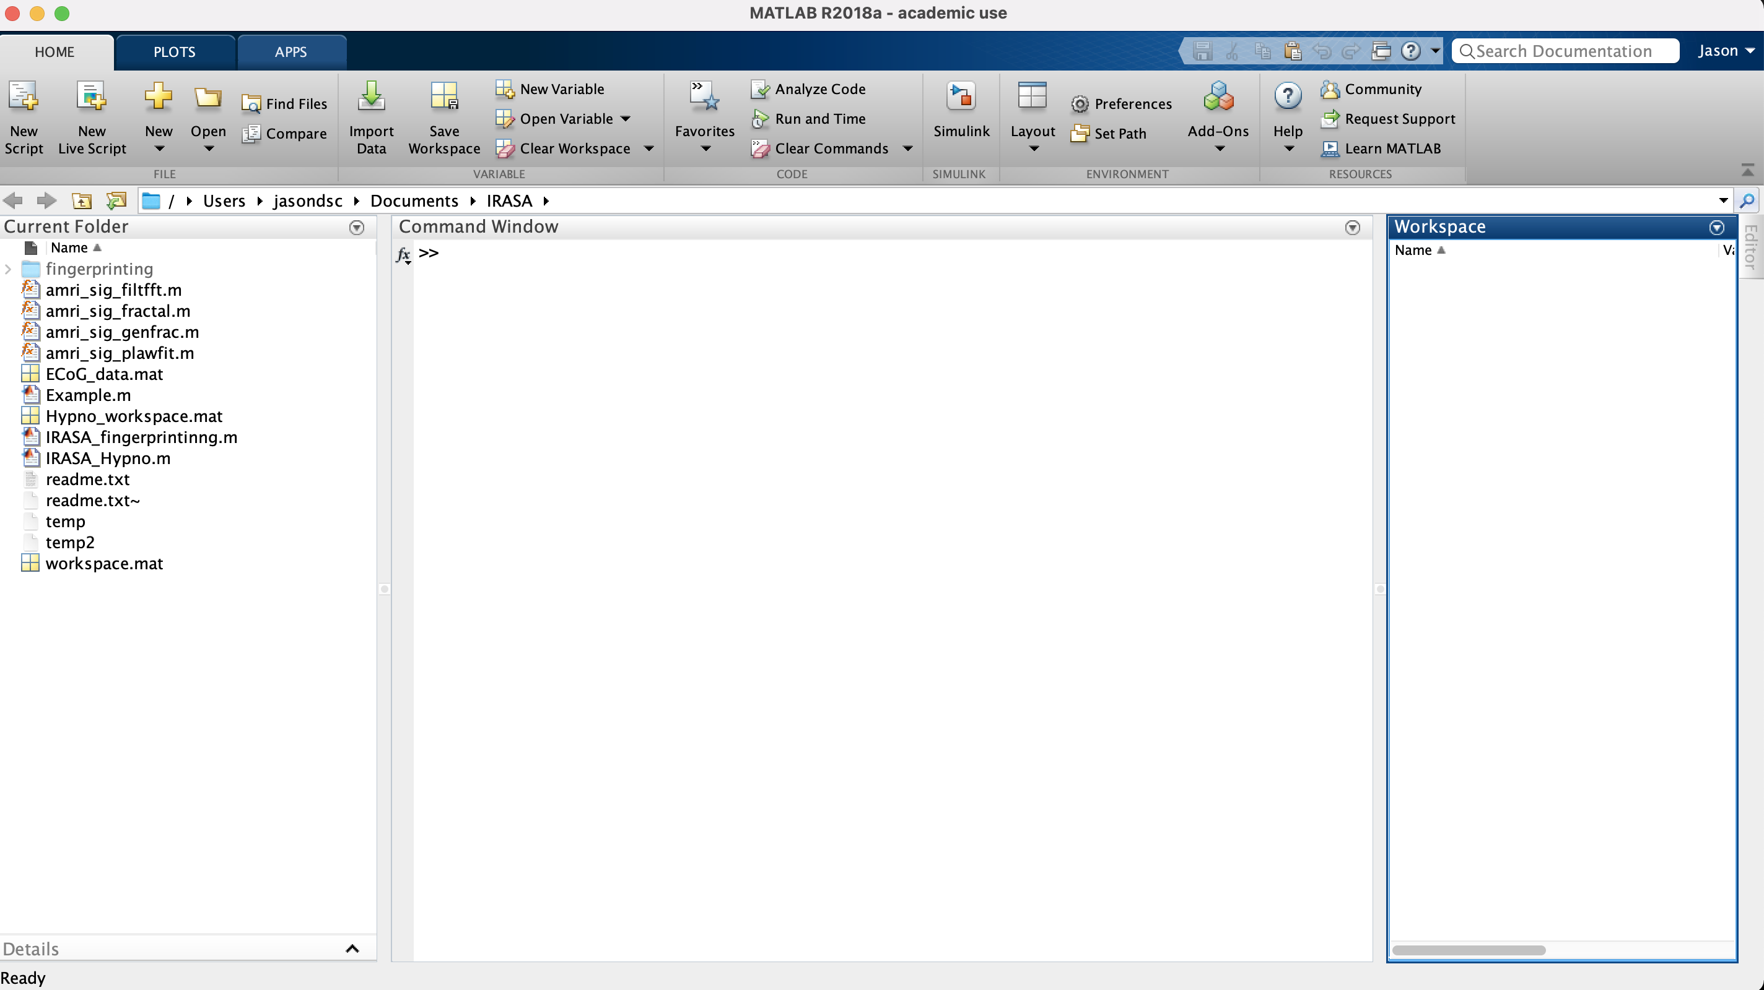

Slide 8


Slide 11
Basic MATLAB Commands
Commands to clean your environment clear, clc and close
To find what files are in a directory dir( )
To find what directory you are in or change it:
pwd( ) and cd( )
To open and write .mat files load( ) and save( )

Slide 12
Basic MATLAB Commands
To check if a variable or file exists: exist()
To list what MTALAB .m and .mat files are in your folder: what( )
To find out which version of a function you are using is: which( )

Slide 13
Functions
Functions are called by using ( ), their outputs and inputs can vary
Example calls of functions:
max(a);
figure or figure()
[maxA, location] = max(A);
[~, name, ext] = fileparts( helpfile );
coeff = pca(X(:,3:15), 'Rows’, 'pairwise');

Slide 14

Functions
Functions are called by using ( ), their outputs and inputs can vary
Example calls of functions:
max(a);
figure or figure()
[maxA, location] = max(A);
[~, name, ext] = fileparts(helpFile);
coeff = pca(X(:,3:15), 'Rows’, 'pairwise');

Slide 15
Help Function
When you are unclear on what a function does, takes as inputs, or outputs you can always ask for HELP
The function help (followed by a function name) returns a description of that function. For details read more about each function on MATLAB’s website

Slide 16
Help Example
>> help fileparts
fileparts Filename parts.
[FILEPATH, NAME, EXT] = fileparts(FILE) returns the path, file name, and file name extension for the specified FILE. The FILE input is the name of a file or folder, and can include a path and file name extension. The function interprets all characters following the right-most path delimiter as a file name plus extension.
If the FILE input consists of a folder name only, be sure that the right-most character is a path delimiter (/ or \). Othewise, fileparts parses the trailing portion of FILE as the name of a file and returns it in NAME instead of in FILEPATH.

Slide 17
What is a variable
A variable is assigning a location in memory some information you want to keep for later
variable_a = 514,398,6644

Slide 18
What is a variable
A variable is assigning a location in memory some information you want to keep for later
num = 514,398,6644
num

Slide 19
Data Types
Char
Booleans
Integers
Variables that represent words or text
Variables that are either TRUE or FALSE
Variables that represent numbers

Slide 20

Data Types
Char
Booleans
Integers
Variables that represent words or text
Variables that are either TRUE or FALSE
Variables that represent numbers

Slide 21
Booleans
Variable that can only take two states: TRUE or FLASE
Used in accessing information, loops, and conditional statements
They are the computer’s equivalent to a question

Slide 22
Boolean Operators
How can we ask the computer a question:
Is equal to ==
Is greater than >
Is less than <
Is NOT equal to ~=
The OR operator ||
The AND operator &&

Slide 23

Boolean Operators
Two very special operators: AND and OR

Slide 24
Boolean Operators
Two very special operators: AND and OR
AND

Slide 25
Boolean Operators
Two very special operators: AND and OR
OR

Slide 26
Integers
Variable type to hold numeric information:
int(8-64) — real integer value
double— decimal number
unit8/16/32 — stores info in 1, 2 etc bytes
complex numbers — numbers with real and imaginary values

Slide 27
Char and Strings
Holds information concerning words/ text
char — single or array of alpha-numeric symbols ‘ ‘ string — array of text “ ”
for most purposes it does not matter which you use

Slide 28
Char and Strings differences
secret_message = [‘a’ ; 'ab’ ; 'abc’]
secret_message = [“a” ; “ab” ; “abc”]
word= 'abc’ ; word(2)
word= “abc” ; word{1}(2)
** these differences have to do with how char and strings are stored in memory

Slide 29
String Operators
contains() looks for a pattern within a string or array of strings
strrep() replaces a pattern with a new string
strfind() find indexes of pattern in string
replace() replaces string pattern with new string
strcat() concatenates two strings
split() splits strings according to delimiter
strcmp() compares two strings

Slide 30
Data Structures
Matrices
Multi-dimensional Matrix
Arrays
Two-dimensional matrix of variables of the SAME type
One dimensional list of variables of the SAME type
Like a matrix but with 3+ dimensions

Slide 31
Matrix Operations
Defining arrays and matrices:
ALL VARIABLES MUST BE OF THE SAME TYPE
a= [1 2 3; 4 5 6; 7 8 9]
words= [‘abc’; ‘def’; ‘ghi’]
z = zeros(5,1)
n=ones(10,5);

Slide 32
Matrix Operations
Basic matrix operations:
n + 10 (adds 10 to each value in the matrix)
a *2 (multiply each element of matrix by 2)
a’ (transpose of a matrix)
a.*a (element wise multiplication)
n*z (matrix multiplication resulting in 10 by 1 matrix)

Slide 33
Matrix Operations
Basic matrix operations:
It is important to note that operators that have a ‘.’ ahead preform ELEMENTWISE operations so
a.*b ~= a*b

Slide 34
Matrix Operations
Array and Matrix Indexing a= [1 2 3; 4 5 6; 7 8 9];
Get the first element: a(1,1)
Get second element of first row: a(1,2)
Get first row: a(1, :)
Get first column: a(: ,1)
Get first three elements of the second row: a(2, 1:3)
Note: you can index by multiples e.g. 1:2:100

Slide 35
Matrix Operations
Matrix manipulation:
zeros: create a matrix of all zeros
ones: create a matrix of all ones
eye: create identify matrix
size: returns matrix dimensions
eig: evaluates eigenvalues and eigenvectors
det: returns determinant of matrix
inv: returns inverse of matrix

Slide 36
Matrix Operations
Reshape is a useful function to transform any sized matrix into a different shape
Reshape(X, [new dimensions])
Note that the new dimensions need to be consistent with the previous ones
i.e., dim1*dim2*dim3 == newdim1*newdim2 etc..

Slide 37
I/O introduction
As we have seen we can load .mat data files with load()
For other types of data we can use MATLAB’s import tools
Simple text files can be read with csvread() or tdfread() these only accept numeric values. Refer to readtable() for strings or mixed type .csv files
** note that MATLAB after 2019 recommends readmatrix()

Slide 38
RESOURCES
https://www.mathworks.com/
https://stackoverflow.com
Mastering MATLAB
Analyzing Neural Time Series Data

